Slide 1

Project #1
Exploring the Relationship
Between 2 Datasets:
AirBNB & Starbucks

Slide 2

Matt Dipinto
Git Master
Data Cleanser
Plot Master
When Matt’s not sharing links to the class on slack, you can find him sneaking Belle into Christmas Parties.

Slide 3

Christine Kanouff
Visual Effects
Story Teller
Editor
When Christine’s not prompting ChatGPT for help, she’s planning her next bucket list trip.

Slide 4

Cindy Zhou
Developer
Mapping Queen
Data Specialist
When Cindy’s not fast tracking through class assignments, she’s spending time with friends at Cirque Soleil.

Slide 5
Project Overview
Data Collection & Cleanup
Approach
Questions & Challenges
Results & Conclusions

Slide 6
Project Overview
We wanted to explore an interesting dataset. This meant no sports data and no financial information. Things we had in common? The Airbnb data looked interesting and a belief that Starbucks probably had the most reliable way to predict store location success.
The Questions We Hoped to Answer:
Is the Airbnb market growing?
What is the relationship between Starbucks and Airbnb locations?
How does the proximity and density of the relationship correlate?
Do Starbucks locations make a difference in the quality of the Airbnb Review or cost of average occupant stay?
What does it look like if we compare 2 diverse markets?

Slide 7
Eliminated Columns (75) Down to 30 Total
Filled NA Data & Replace Null With -1
Cleaned Price Column and Standardized as Float
Converted Bathroom to Number
Removed Outliers (over $2,000)
Converted Dates to Datetime
Pulled in Airbnb Reviews Data
Calculated how often ”Starbucks” was mentioned in review
Airbnb
Data
Cleanup
Selected Columns to Keep
Filter for Location
Postal Code Standardized to Five Digits
Found Average Latitude and Longitude
Calculated within 25 Mile Radius of all Starbucks Locations
Starbucks
Data Cleanup

Slide 8
Data Section, Collection & Cleanup
What Questions Could the Data Help us Answer?
How to Show Results?
Project Overview

Slide 9
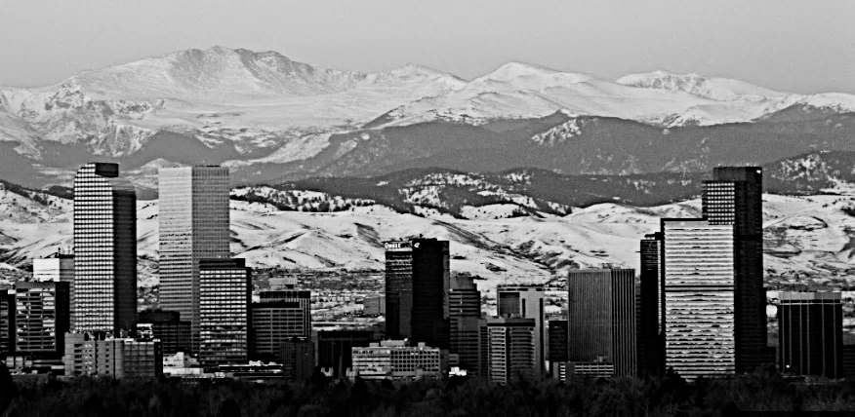


303 Denver Starbucks
5,367 Denver Airbnb Sites
London
 | 333
 | 5,367
Denver

Slide 10

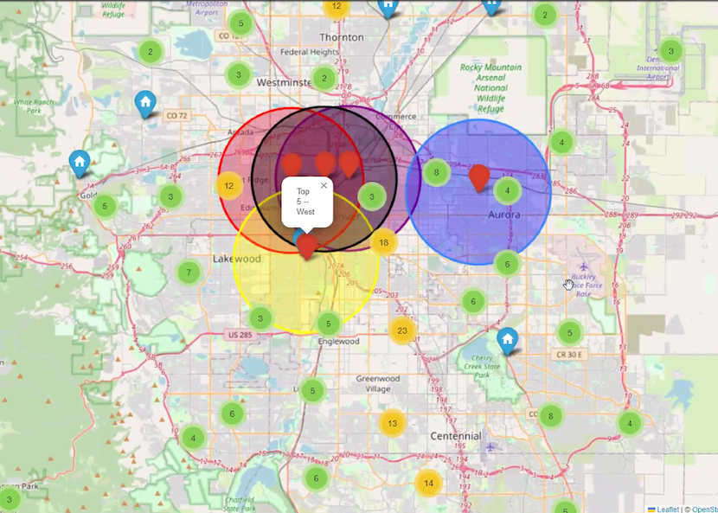
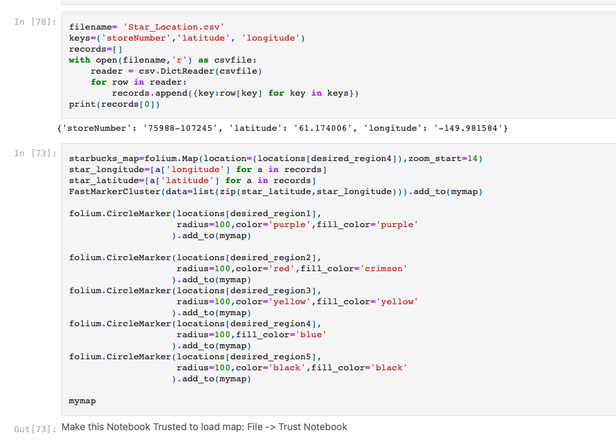
Exploring the Data
District Map

Slide 11
Question: Is The Airbnb Business Still Growing?
Cindy is working on visual(s) for this.

Slide 12
Yes, market is still growing Time Series info.
Upon reflection we looked at 2 diverse markets:
Denver vs London
-Mapped Out Data to Confirm Hypoth
-What does tagging to Starbucks locations reveal?
Proximity to Starbucks
Reviews to Location

Slide 13
Denver, Colorado
After Cleanup, Final Datasets Included:
303 Denver Starbucks
5,367 Denver Airbnb Sites
In 5 Major Denver Neighborhoods

Slide 14
Exploring The Data

Slide 15
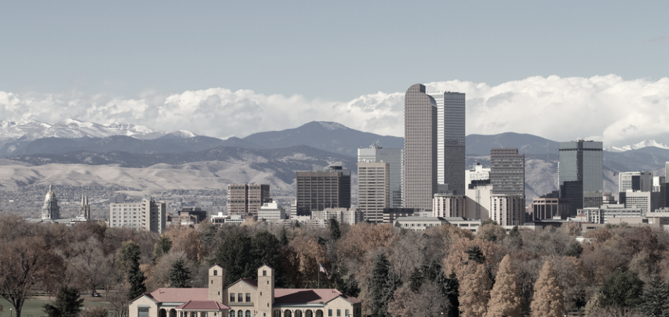
Challenges: These ”Districts” are Assigned Lat/Long
“District”
Names:
Fivepoints
Northwest
West
Northeast
Highland
”Normal” Names:
Downtown
Cherry Creek
DU
Bakers
West

Slide 16
Question: Is There A Correlation Between Airbnb Top Reviews and Proximity to Starbucks?
Matt has a graph of this in files. Clean-up…

Slide 17
Question: What Type of Property Is Getting The Best
Reviews?

Slide 18
Question: Are There Any “Obvious” Opportunities
Due to High Density of Starbucks and
Low Density of Airbnb?
We discussed doing a “visual” estimation of this using the maps we already have.

Slide 19
Resources & Articles
https://www.networkworld.com/article/935670/big-data-secrets-from-airbnb-starbucks-and-sonic.html
https://nycdatascience.com/blog/student-works/data-analysis-on-starbucks-location/

Slide 20

Anthony
Our Client:
Semi-retired actor who wants to add a reliable income stream to his already-healthy portfolio of investments.
Taylor

Slide 21
Hired MCSquared to Determine:
Is an Airbnb…a good long-term investment? And if so…in what market?
Anthony Taylor

Slide 22
Some Background on Airbnb
Published by Statista Research Department, Apr 21, 2023
Airbnb has become a global phenomenon since its founding in 2008. As of April 2023, Airbnb's market capitalization valued at 73.34 billion U.S. dollars, up from 54.13 billion U.S. dollars the previous year. Over the past four years, the company's market capitalization peaked in 2021 at over 100 billion U.S. dollars.
Simple Findings = Incredible Impact
Riley Newman, head of analytics and data science at Airbnb, ran a regression to determine the features of a listing that had the most impact on whether it would get booked, and he unearthed a shockingly simple insight: unappealing looking listings don’t get booked. Appealing ones do.
Taking Action
Airbnb eventually rolled out a tool that allowed hosts to request free professional photo shoots, and in the process, not only did they boost bookings, but they earned a ton of loyalty from the owners.

Slide 23

Why Starbucks Data?
Starbucks built a market-planning and store-development application called Atlas. The best way to think of Atlas is as a Big Data analytics tool layered on top of mapping software. Built on Esri’s ArcGIS (GIS stands for Geographic Information System), Atlas lets Starbucks factor in a range of variables that contribute to the success of existing stores, visualize them on maps, and then seek out similar areas for new locations.

Slide 24
Data Section, Collection & Cleanup
What Questions Could the Data Help us Answer?
How to Show Results?
Project Overview
?

